Slide 1
Credit Card Approval Prediction

Slide 2
Context
Credit score cards are a common risk control method in the financial industry. It uses personal information and data submitted by credit card applicants to predict the probability of future defaults and credit card borrowings. The bank is able to decide whether to issue a credit card to the applicant. Credit scores can objectively quantify the magnitude of risk.

Slide 3
Dataset Description
The selected dataset is based on historical data of users. Most of the variables type are Categorical and Binary.
Variables | Explanation | Type
ID | Customer Id | Categorical-unordered
CODE_GENDER | Gender of Customer | Binary class M ,F
NAME_FAMILY_STATUS | Marital Status | Categorical-unordered
NAME_HOUSING_TYPE | Living Situation | Categorical-unordered
CNT_CHILDREN | No of children | Categorical-unordered
AMT_INCOME_TOTAL | Total income | Categorical-unordered
NAME_INCOME_TYPE | Income type | Categorical-unordered
NAME_EDUCATION_TYPE | Education Level | Categorical-unordered
DAYS_BIRTH | Date of birth | Categorical-unordered
DAYS_EMPLOYED | Start date of employment | Categorical-unordered
FLAG_MOBIL | Is there any customer mobile phone | Binary
FLAG_WORK_PHONE | Is there any customer work phone | Binary
FLAG_PHONE | Is there any phone | Binary
FLAG_EMAIL | Is there any customer email | Binary
OCCUPATION_TYPE | Type of occupation of customer | Categorical-unordered
CNT_FAM_MEMBERS | Total no of members in family | Categorical-unordered

Slide 4
Class Label
The column ‘status’ is class label which I have transformed into target column that represents if an applicant is bad or good client.
There were 8 labels in my class. X: No loan for the month;
C: paid off that month;
0: 1-29 days past due;
1: 30-59 days past due;
2: 60-89 days overdue;
3: 90-119 days overdue;
4: 120-149 days overdue;
5: Overdue or bad debts, write-offs for more than 150 days
The clients whose overdue was more than 60 days. I marked these users as a bad client with class label 1 and 0 represents the good client with overdue no more than 60 days

Slide 5
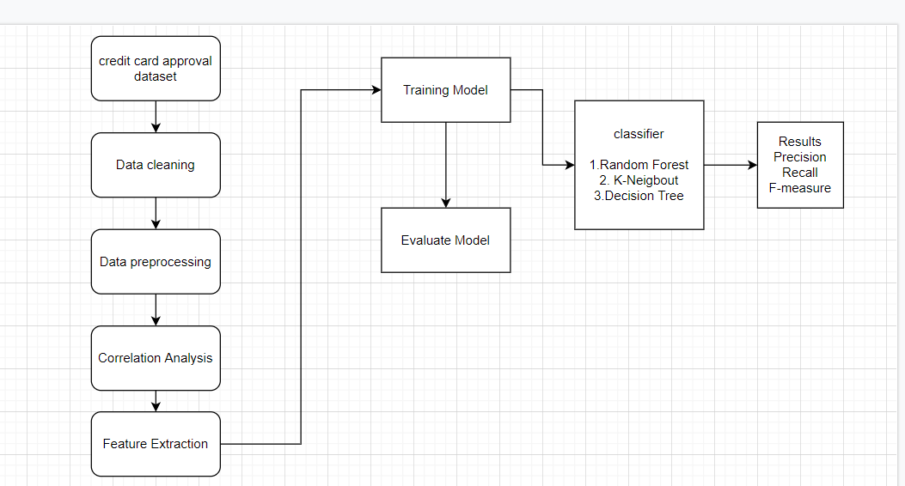
Methodology

Slide 6
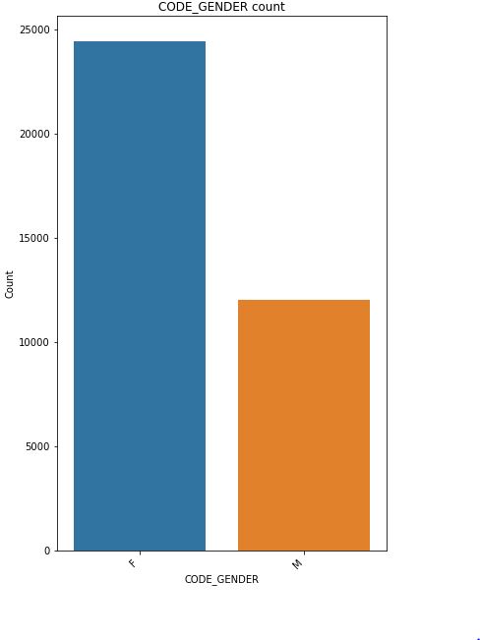
Exploratory Data Analysis
Total female and male ratio in dataset
There were around 12000 females
and 24000 males in a dataset

Slide 7
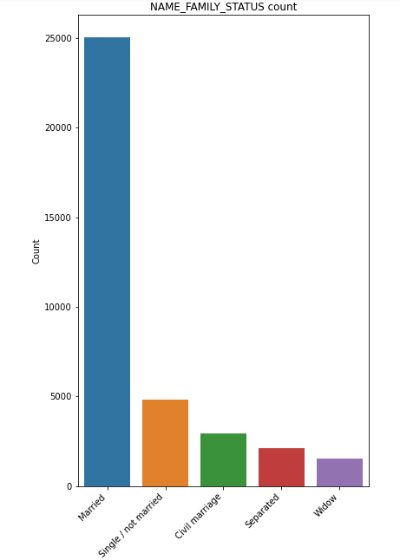
EDA Cont..
Married 25048 68.705598
Single / not married 4829 13.245742
Civil marriage 2945 8.078010
Separated 2103 5.768440
Widow 1532 4.202211

Slide 8
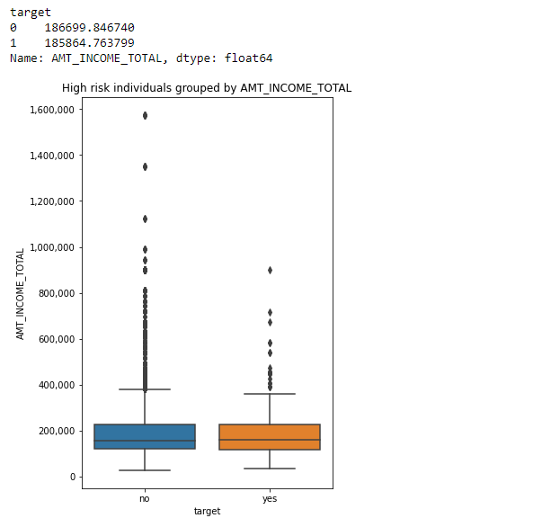
EDA Cont..
Low Risk user
High risk and low risk applicants
have roughly similar income

Slide 9
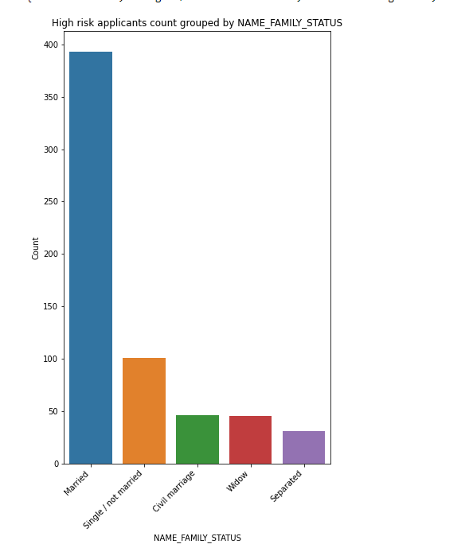
EDA cont..
Higher risk analysis by marital status

Slide 10
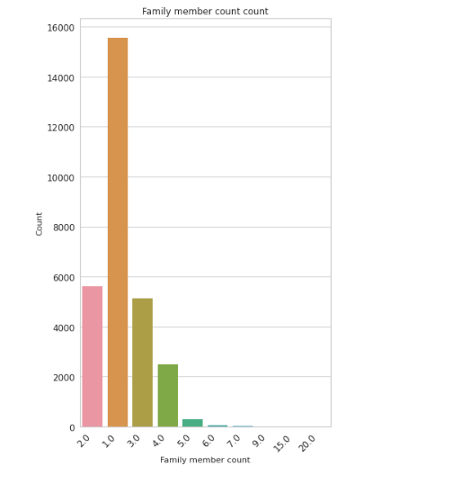
EDA cont..
Most applicants are two in their household, this is also confirmed with the fact that most don’t have a child (more on this in a bit)

Slide 11
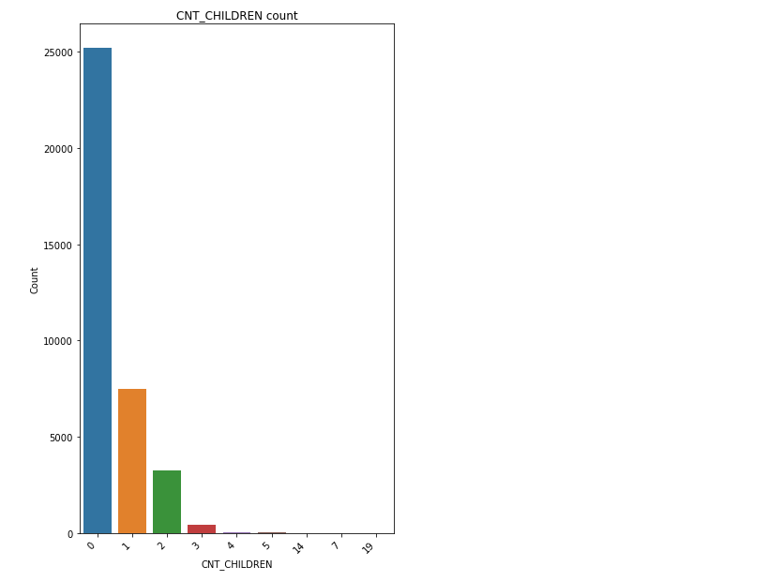
EDA cont..

Slide 12
Data Preprocessing
Conversion of days format features to readable format
DAYS_BIRTH to Age
YEARS_EMPLOYED to DAYS_EMPLOYED
Encoding categorical features to Numerical Values
converting categorical features ['CODE_GENDER', 'FLAG_OWN_CAR', 'FLAG_OWN_REALTY', 'NAME_INCOME_TYPE', 'NAME_FAMILY_STATUS', 'OCCUPATION_TYPE', 'NAME_HOUSING_TYPE', 'NAME_EDUCATION_TYPE‘] to numerical values

Slide 13
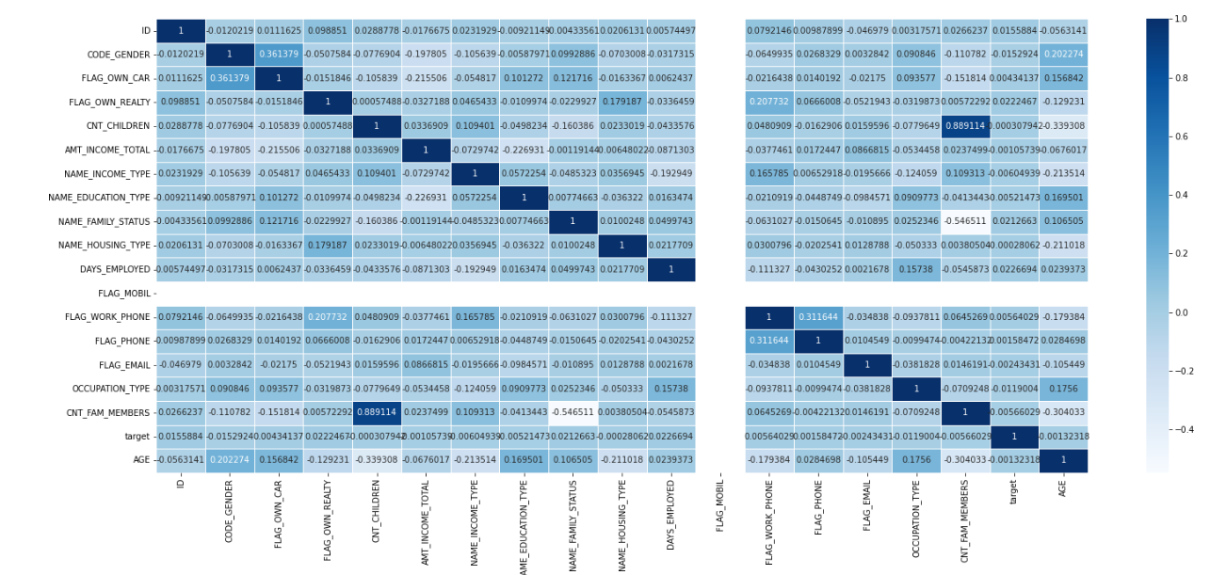
Heat Map Before Normalization

Slide 14
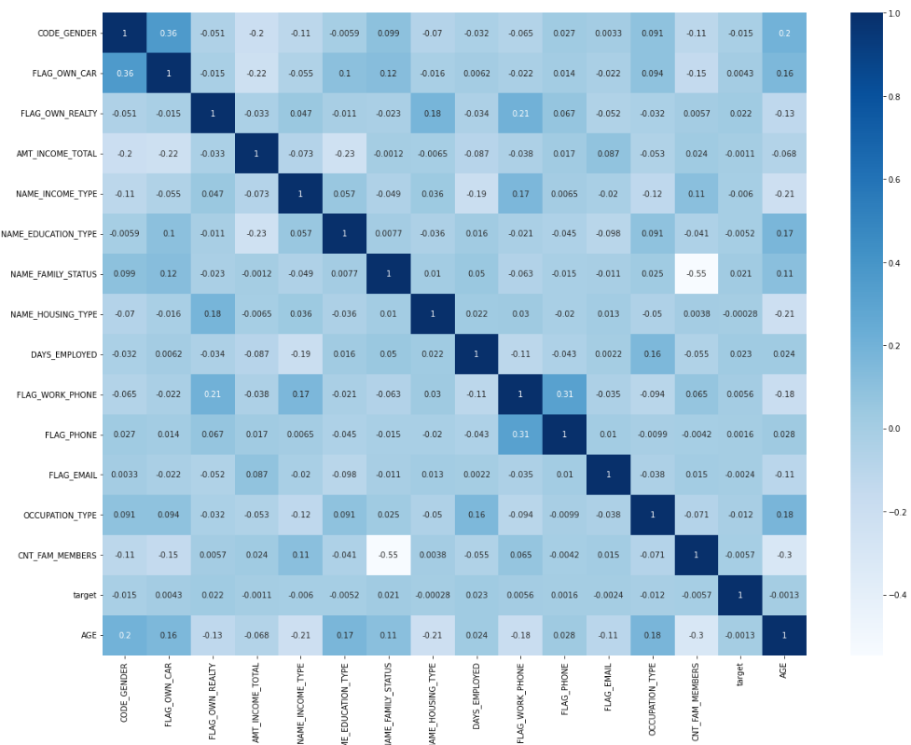
Correlation HeatMap
Based on Corr Heatmap, remove children (beacase high correlation with total_family) and Mobile_phone

Slide 15
Training Model
Splitting dataset into 80% training and 20% for testing.
Classifiers used for training the model
Decision Tree
Accuracy: 0.9809
Random Forest
Accuracy:0.9879
K-Neighbour :
Accuracy:0.9839

